Slide 1




Group Members: Hamza Latif SP17-BCS-085 Hassan Sharjeel Arshad Joiya SP17-BCS-058
Road Pulse
Supervised By:
Dr. Usama Ijaz Bajwa
Machine Perception & Visual Intelligence Research Group

Slide 2

Detect violation and crash anomaly from videos uploaded by the user.
The proposed system will provide an automated solution to keep the track of such events and respond in real-time
Assist the law enforcement departments. Improve traffic management and restore laws and regulations for the public
Introduction
This result is achieved through implementing Image Processing and Deep Learning model.
Notes:
https://unsplash.com/photos/JjsAlrtKGGs

Slide 3
Main Motive
The main motive to design and develop such a system is to reduce the number of road accidents by ensuring proper traffic regulation and management.
The system will also help and assist law enforcement agencies to minimize the traffic violations which will ultimately reduce the risk factor for pedestrians .
Accuracy and quick processing will help such departments to take regarding the set of actions in real-time and to keep track of such events .

Slide 4
Problems
Fast reaction and prevention of traffic violations play a key role to ensure the safety of vehicles and citizens.
Surveillance cameras are installed everywhere to prevent traffic violations but they are unable to detect events like car crash due to the faulty architecture
Some of these events get noticed while others remain unnoticed or when it is already too late.
It is very important for authorities to reach the site of incident as early as possible to minimize the damage caused.

Slide 5
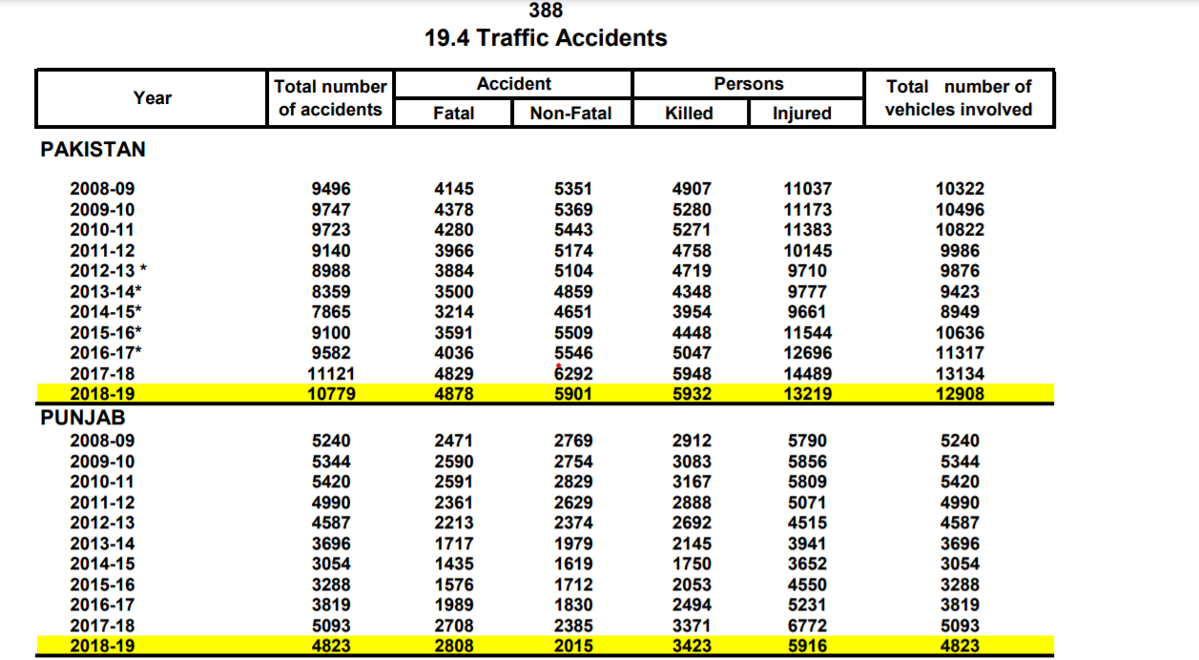
Problems
Crimes reported in Punjab circa 2015-2018, Pakistan Bureau of Statistics (pbs.gov.pk)

Slide 6
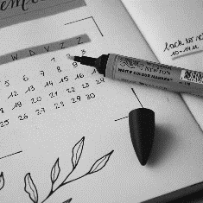
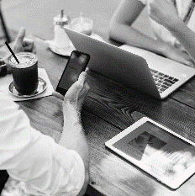
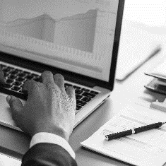

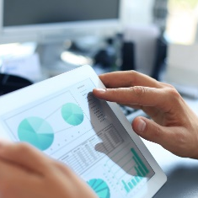
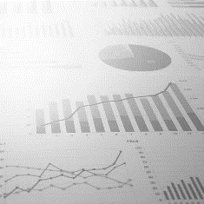
Our Solution
Anomaly Detection
Detect and extract’s main anomaly events through thresholding parameter
Generate Alert
Transfer key evet anomaly snippets to Android Application
Preprocessing
Analysis video and feeding frames to the model
01
02
03
04
05
06
INPUT
Uploading Video
Output
Process video of anomaly frames and display on web page
Inferencing Model
Processed frames are fed to the Pre-Trained FCN model to obtain probability outputs

Slide 7
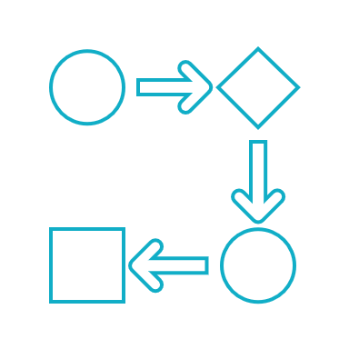

Features
Our application is running on CPU and providing high computational results
Model is integrated with flask server and starts processing as soon the video is uploaded
Run detection frame by frame(of uploaded video) and saves the output frames as well
Can work with videos of any resolution and length

Slide 8
CONSTRAINTS
Accuracy of detection depends upon the quality of the dataset available.
API connectivity is complex while the application development
The video stream angle should be accurate enough so that violations can be detected properly
Compatibility issues may arise during the model deployment

Slide 9
Tasks
Create end user application
Acquisition of the dataset.
Under Progress
Research and find solutions of the problem.
Create anomalous snippets
Define Thresholding criteria
Prediction & detection using FCN yolo v3 model.
Calculating the anomaly & Violation score

Slide 10




Dataset
AI City Challenge 2019.
200 Videos
(100 Lane Violation+ 100 Vehicle Crash)
2 Classes : Lane Violation + Crash
Training: 100 Videos
Test: 100 Videos

Slide 11
Implementation
Preprocessing
Inference Model
Road Pulse
Under Progress
Creating Snippets
Anomaly and Violation Detection

Slide 12
Preprocessing
Take input video frame by frame.
Process the video frames.
Resize images to 416 x416
Preprocessing

Slide 13
Anomaly Detection
For each of the frames extracted from the input video. Predict the anomaly scores using our custom trained YOLO V3 model.
Run detection after reading video frames and prediction score is then assigned to each frame in that video clip.
Get a score for each frame of the video based upon statistical analysis.
If there is a deviation in scores, assume that an anomaly must have occurred in that part.
Anomaly Detection

Slide 14
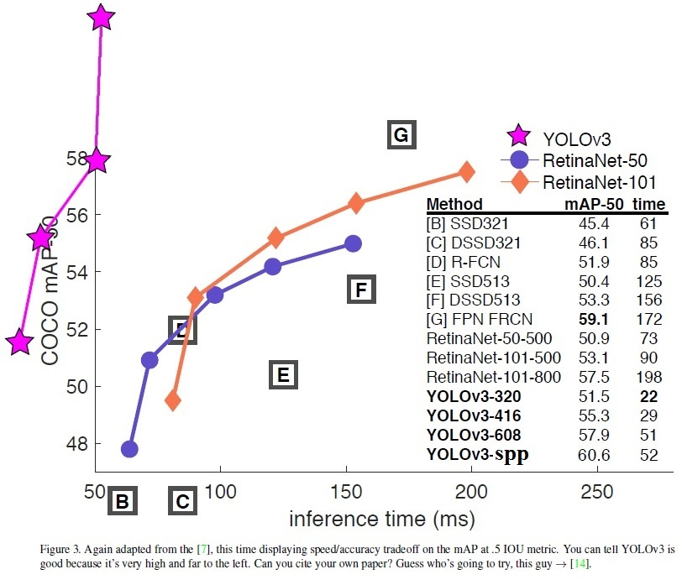
Benchmarking
Benchmarking of YOLO V3
YOLO V3 Comparison with other object detection models
Reference :https://towardsdatascience.com/review-yolov3-you-only-look-once-object-detection-eab75d7a1ba6

Slide 15
Pipeline
Trained our model on custom classes .Custom classes include Lane Violation and vehicle crash.
The weight files were saved in form iterations around after every 2000 frames .This was done to be on the safe side that if training stops at any point we can resume the training.
The training process was done on Google Collab using GPU environment.
The accuracy of the model on test videos were around 75 to 85 % as the frames were limited around 10k frames were trained

Slide 16




Challenges we faced
Labelling the dataset.
Using YOLO V3
Detection & score prediction
Threshold estimation

Slide 17
Labelling the dataset.
Manually labelled the dataset by watching every video (200 Videos).
The labels of dataset were in XML format but later on we discovered that YOLO V3 use labels of .txt format
So all the labels were converted then to YOLO V3 format using a script written in python
Average video length was around 12-13 minutes

Slide 18
Using YOLO V3
‘You Only Look Once’
Problem: Understanding the YOLO V3.
Solution: Extensive research which led to these results:
YOLO makes use of only convolutional layers, making it a fully convolutional network (FCN) which uses deeper architecture of a feature extractor called Darknet-53.
Each layer is followed by a batch normalization layer .No form of pooling is used, and a convolutional layer with stride 2 is used to down sample the feature maps.
This network applies single Neural network to the Full Image which divides the image into regions and predicts bounding boxes and probabilities for each region.

Slide 19

Custom Training Files
Problem: Creating custom training files for our custom classes and extensive training time
Solution:
Used the already available CFG files .Update the main parameters like batch size ,classes, filter size in the convolutional layers.
After first training which was done in around 11 hours reduced the convolutional layers to reduce training time.
Used colab GPU Environment for the training
Implemented the model on our CPU.

Slide 20
Appending Processing
Info
Problem: Tried to display the backened processing to the user on web page .Got compatibility issues with the HTML.
Solution:
Tried to pass the Jason object to the HTML but object was unable to decode.
So the processing output was displayed in browser console

Slide 21

Threshold Estimation
Problem: Defining the threshold for what can be considered an anomalous snippet
Solution:
Static Thresholding:
Use a static value i.e 0.5 to classify anomalous segment.
Dynamic Thresholding:
Frames with scores exceeding the mean of smoothened scores are considered as anomalous.

Slide 22



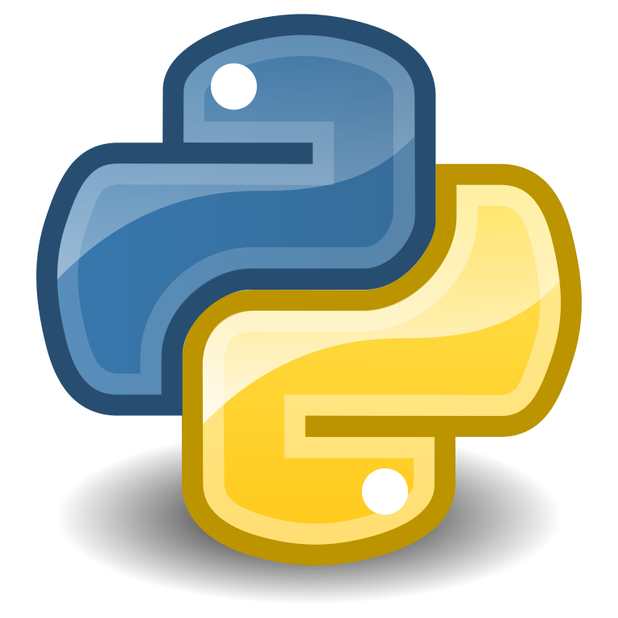


Tools & Technique
Github
Jupyter Notebook
Google Colab
Python
Flask
OpenCV Library

Slide 23
Interface
Road Pulse is a Web + Android application.
Developed using Flask and Android Studio.
.
Interface

Slide 24
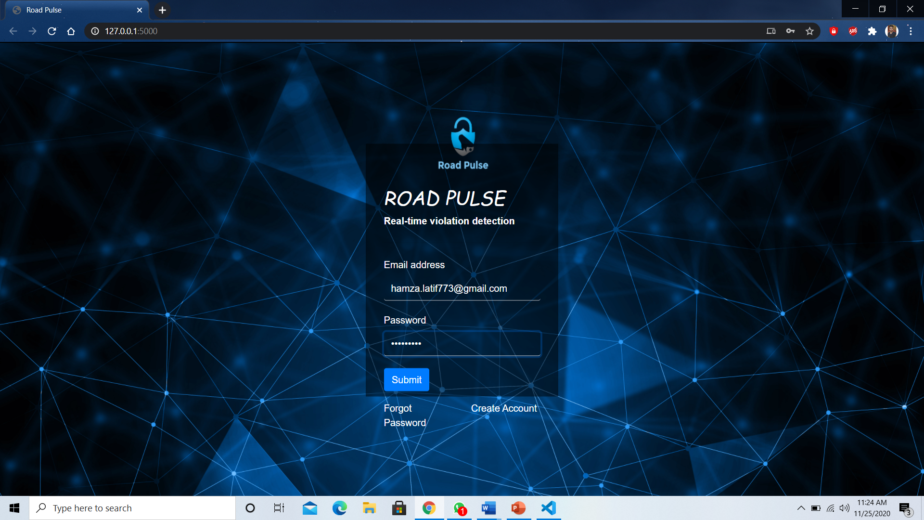
Login
Login Screen

Slide 25
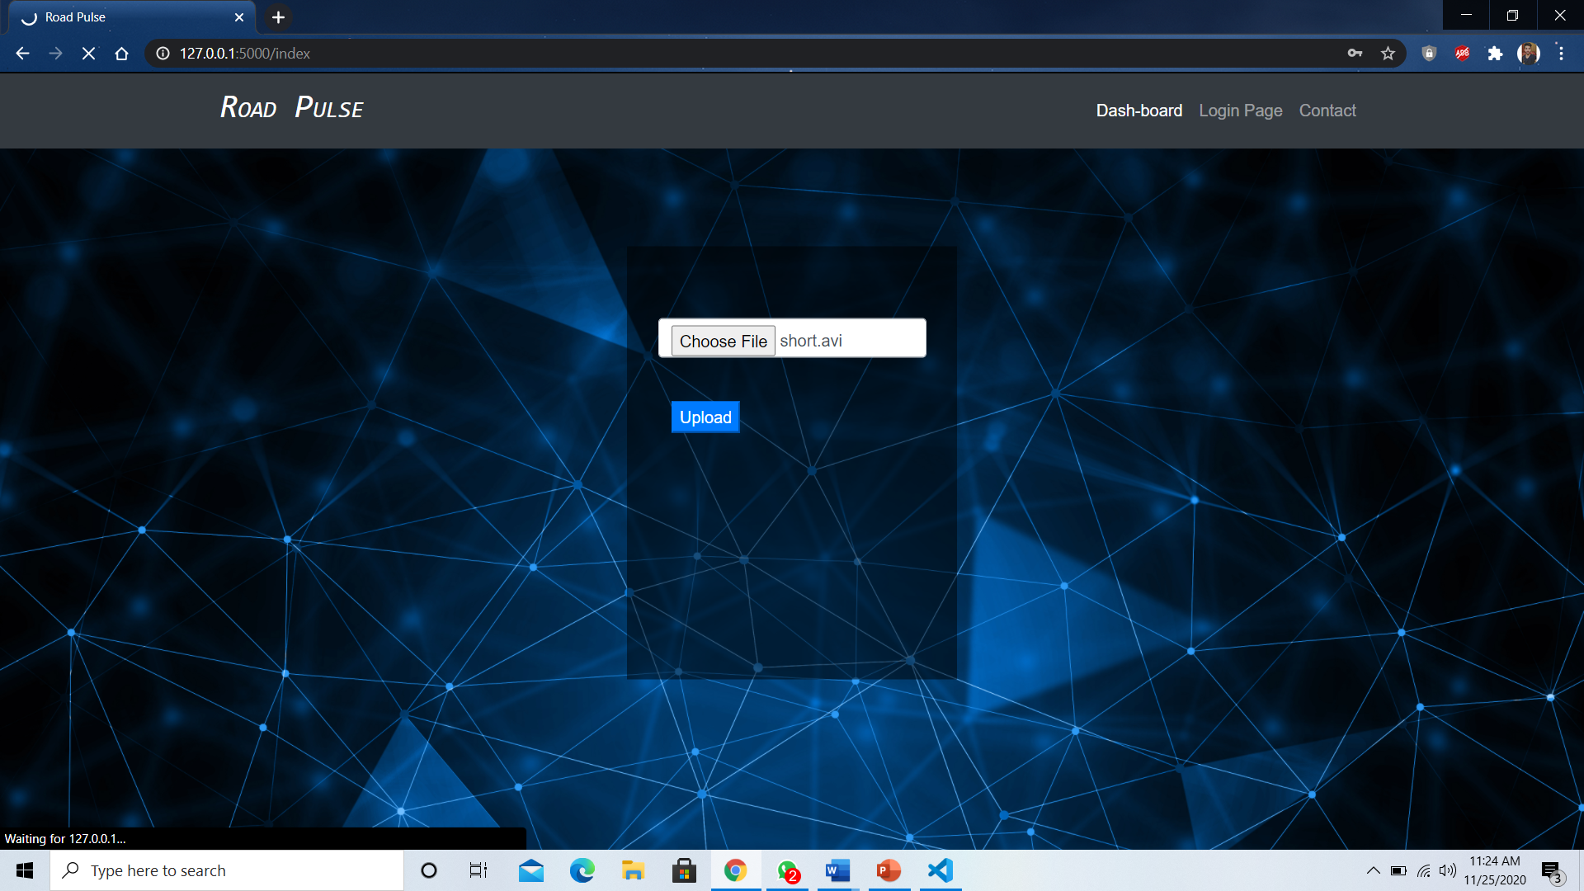
Main Screen
Main Screen

Slide 26
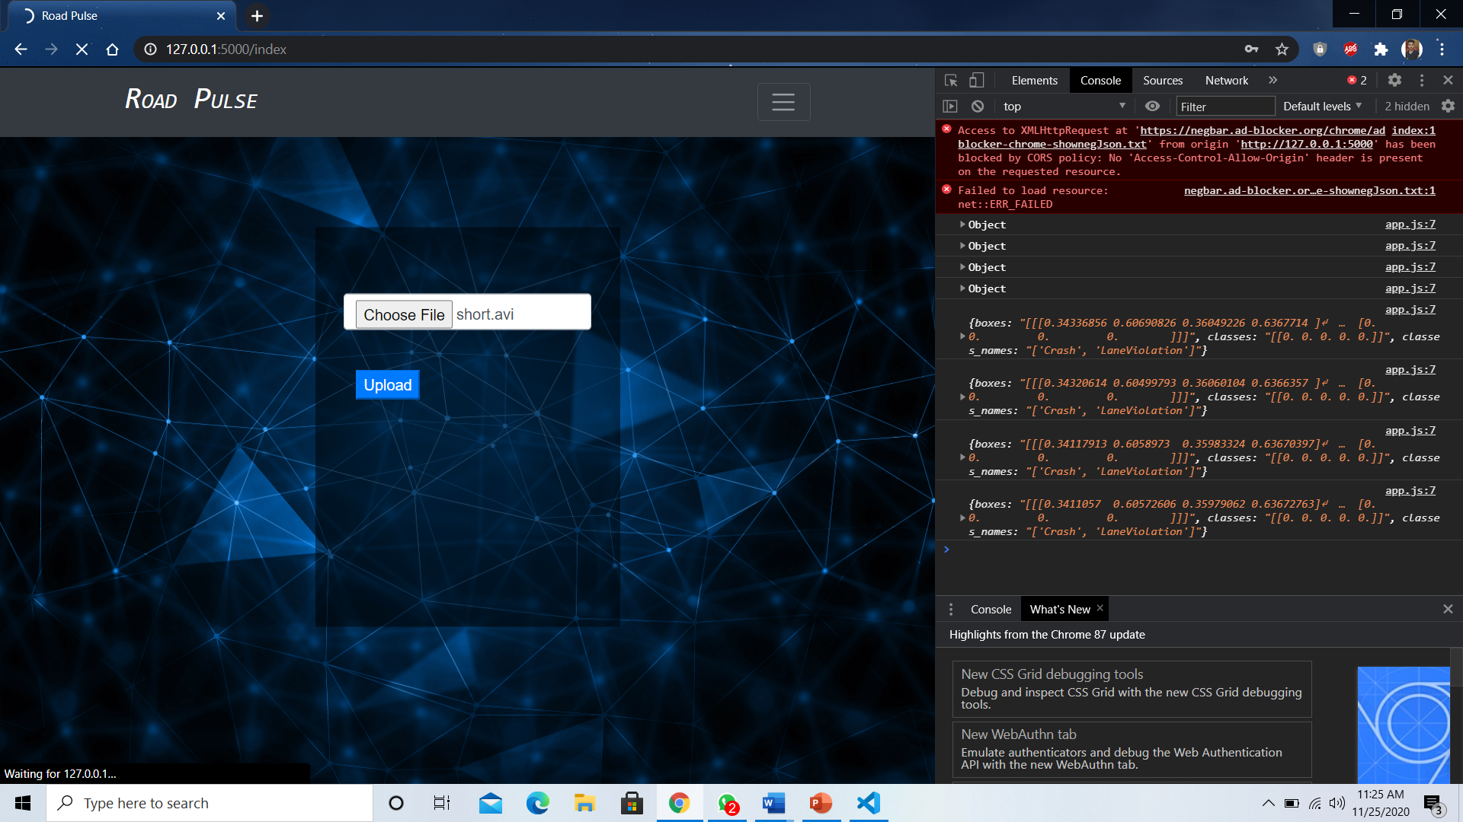
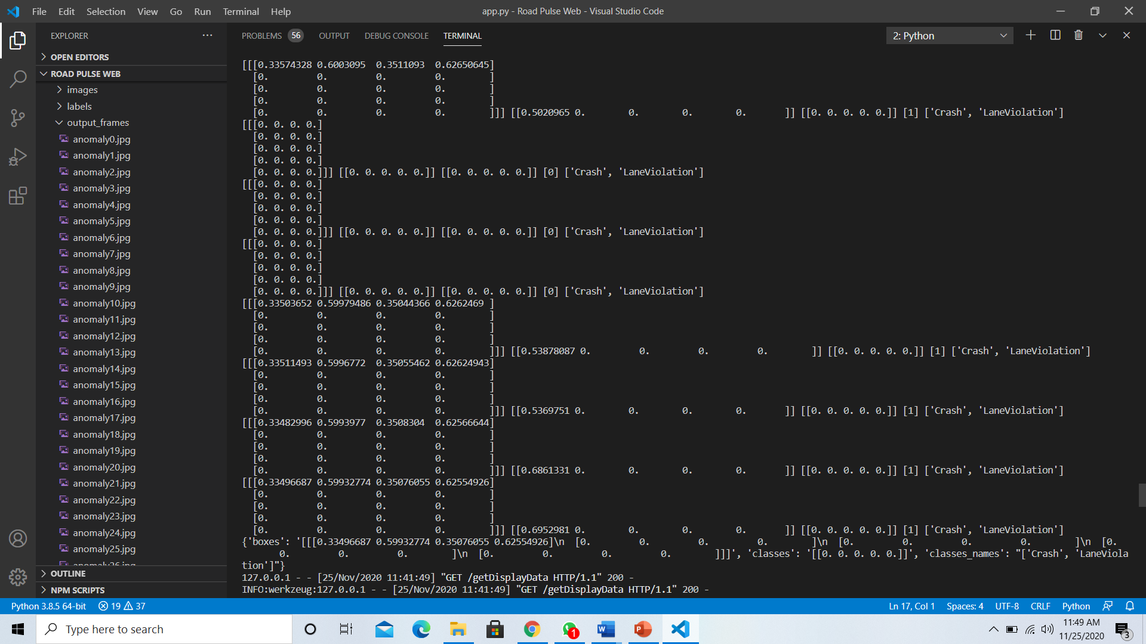
Detection & Processing
Processing displayed on browser console
Frames generation and blackened processing

Slide 27
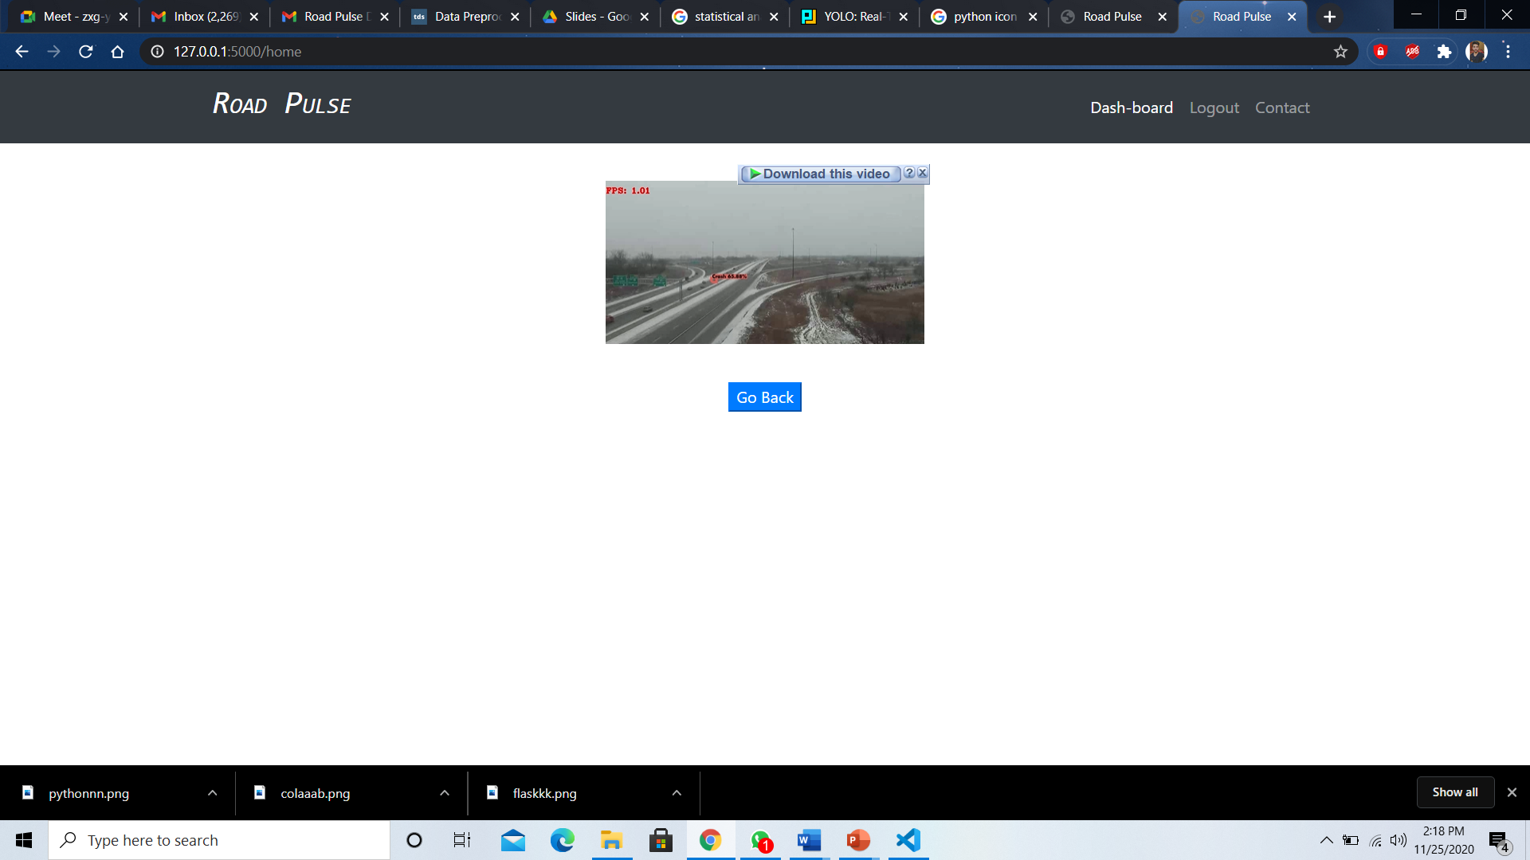
Testing (Normal Video)
Output Video

Slide 28
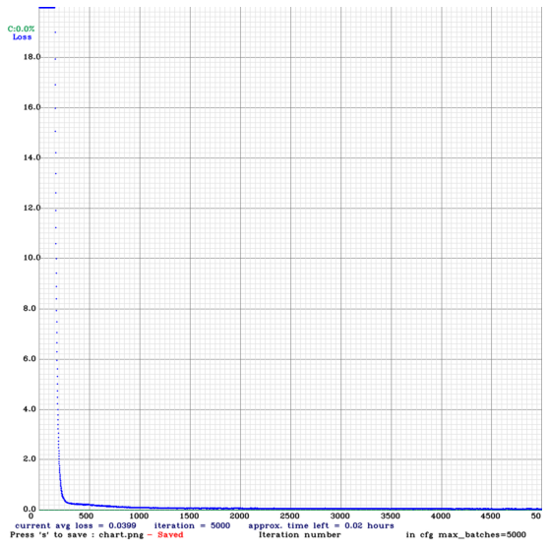
Custom Training

Slide 29
Our Android Application Prototype

Slide 30
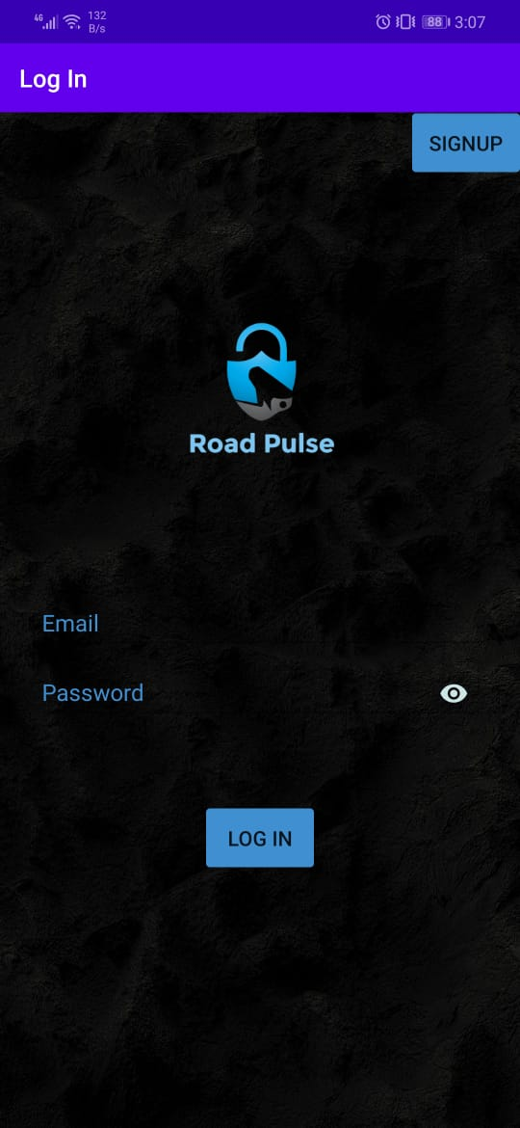
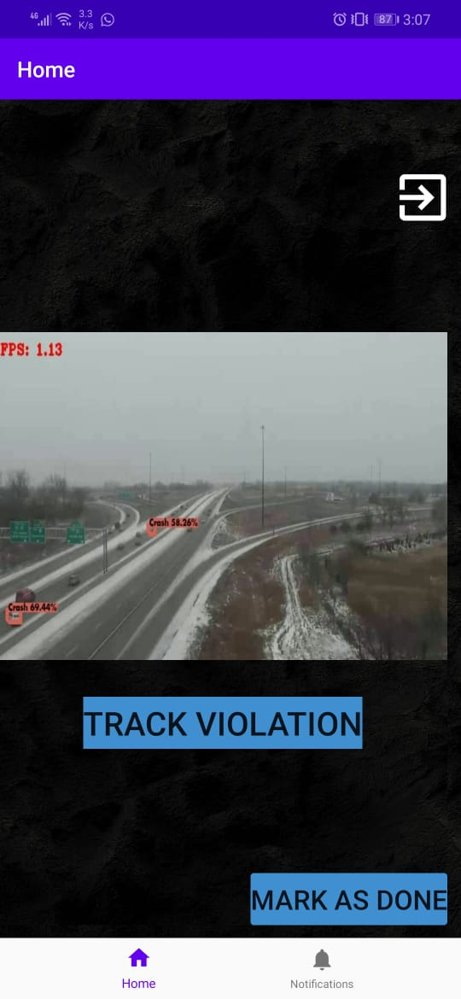
Android Application
Login Screen
Home Screen

Slide 31
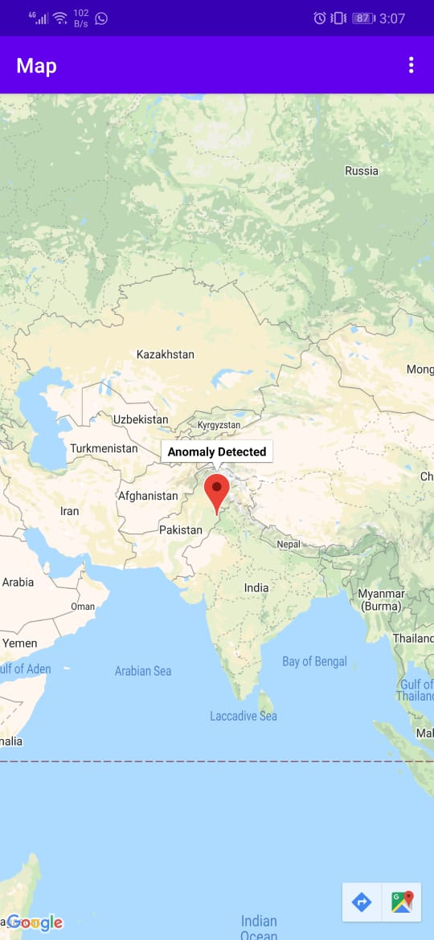
Testing
Pinned Location on Map

Slide 32
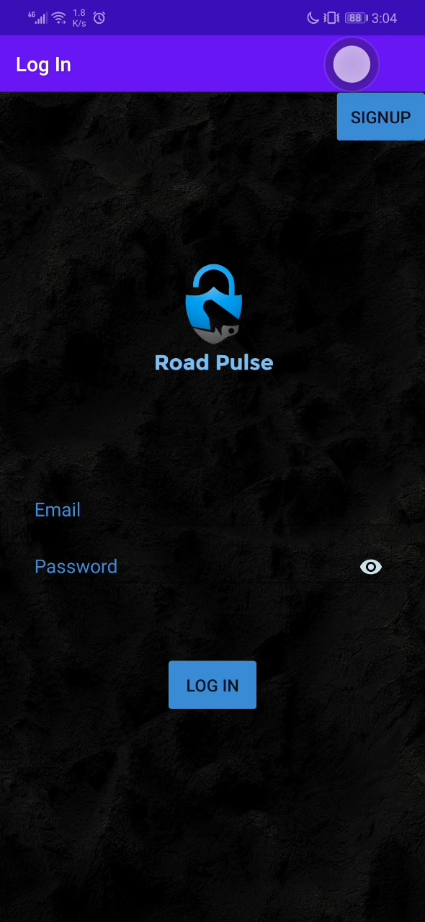
Demo
Demo of Android Application

Slide 33
Future Work
Further extensions on this system are as follows:
Will extend this work to work with live stream of surveillance cameras
Optimizing the performance of our model
Improving Web and android interface
Show more processing visualization to the user
Currently working on generating snippets
.

Slide 34
Acknowledgements
We would like to thank:
Dr. Usama Ijaz Bajwa for his guidance, which allowed us to complete this project.
Members of our Research Group Ms. Ramna
.

Slide 35
Project Links
MPVIR
Our Work is cited at Machine Perception & Visual Intelligence Research Group
https://sites.google.com/view/mpvir/projects/road-pulse?authuser=0
GITHUB REPO
https://github.com/Hamza-773/Road-Pulse.git

Slide 36
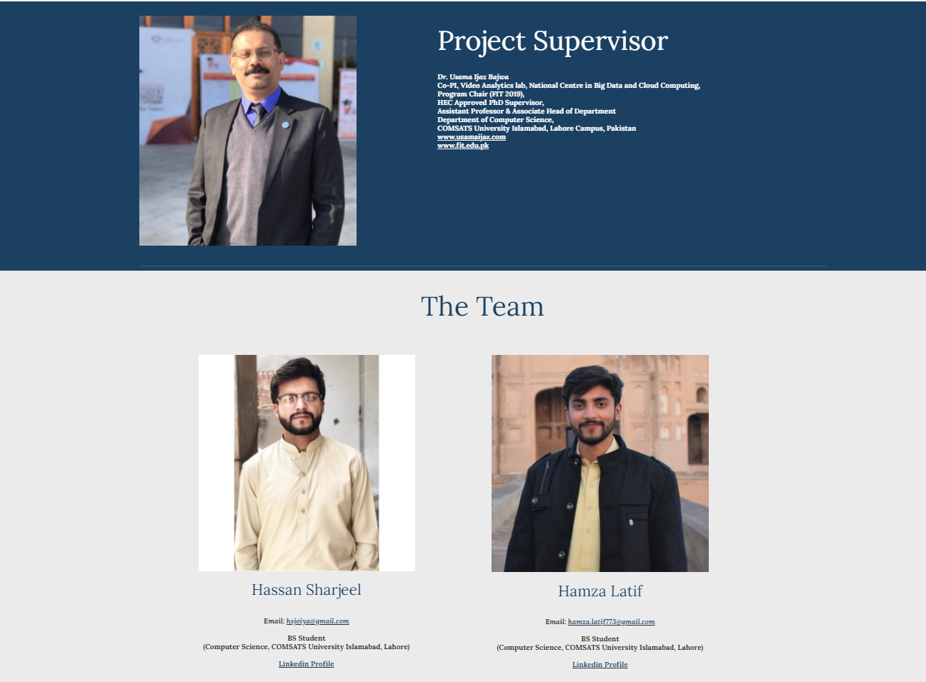
Our Team

Slide 37
Thank You Any Questions?

